Slide 1
Project in Predictive Analytics
Deck 1: Topic Exploration
Presented by:
Yondong Xiang
Kan Zhou
Yuqi Gu

Slide 2
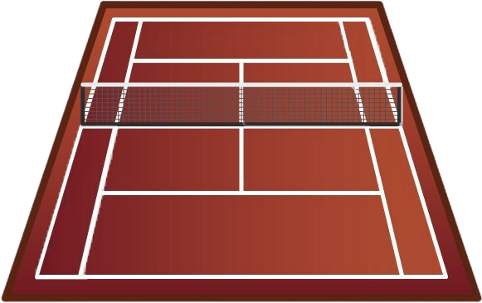

TABLE OF CONTENTS
01
02
03
Canadian Disaster
WTA Match Analytics
Canadian Crop Production
Yongdong
Kan Zhou
Yuqi Gu

Slide 3
Canadian Disaster Dataset
01
Yongdong Xiang

Slide 4
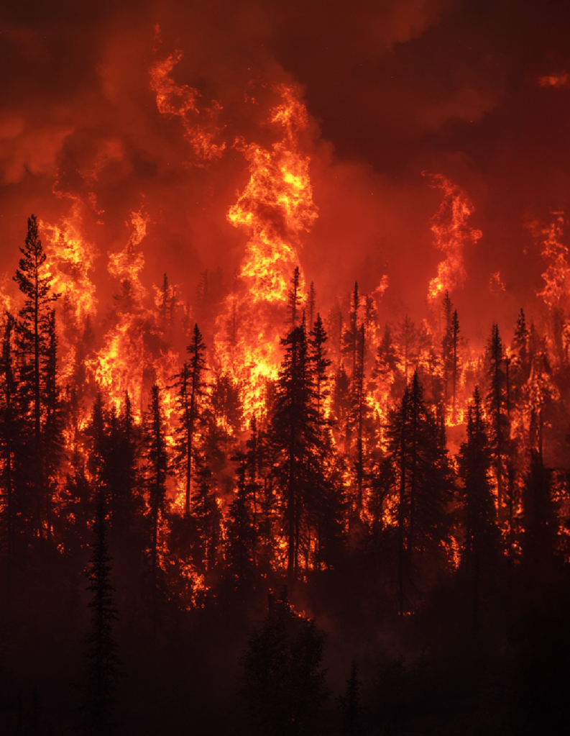
Manitoba Wildfire
Manitoba wildfires forced evacuation of over 17,000 people.
Smoke caused severe air quality warnings across the province.

Slide 5
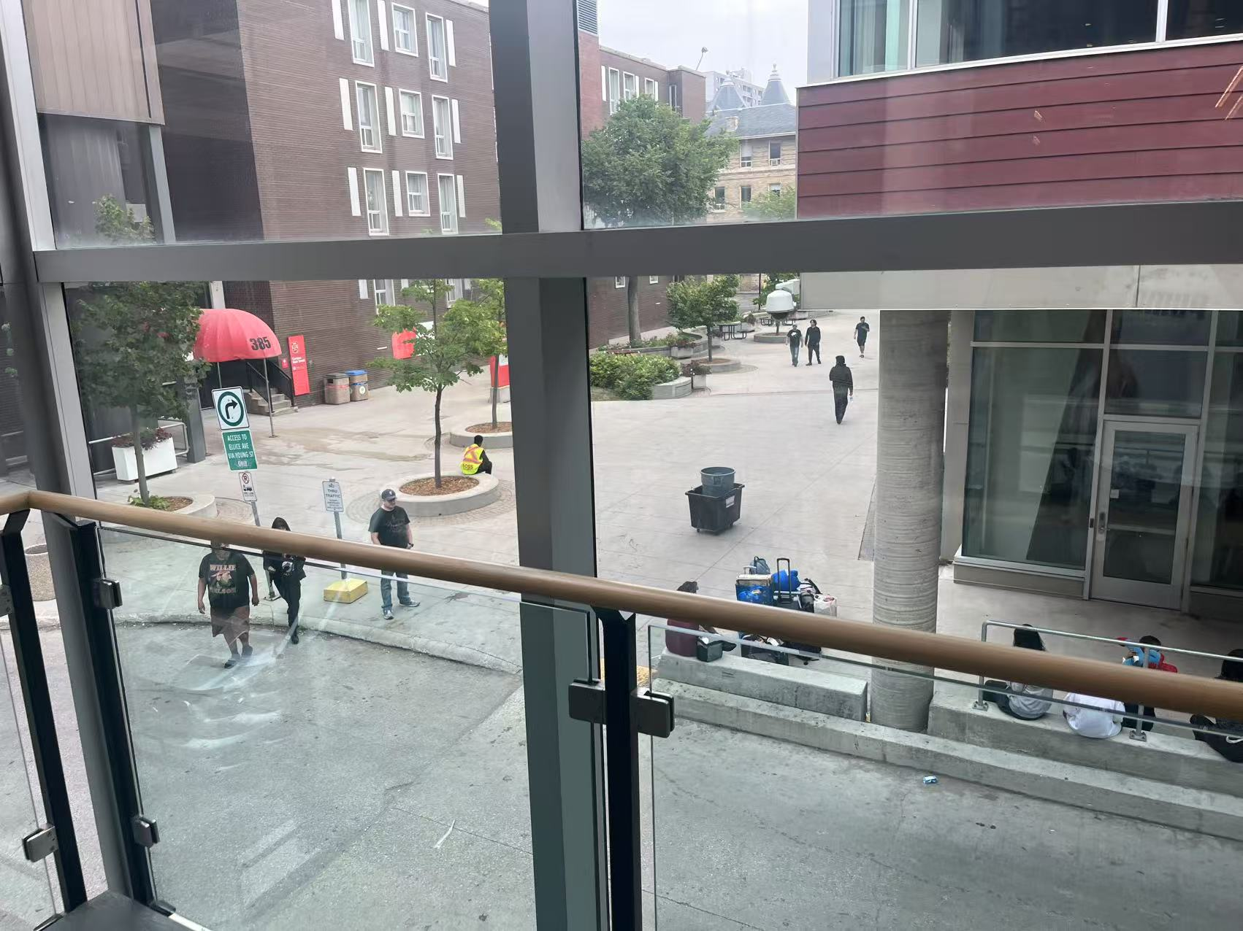

UW Emergency Shelter
About 1,100 Manitoba wildfire evacuees remain in group shelters
UW facilities are used as emergency shelter

Slide 6
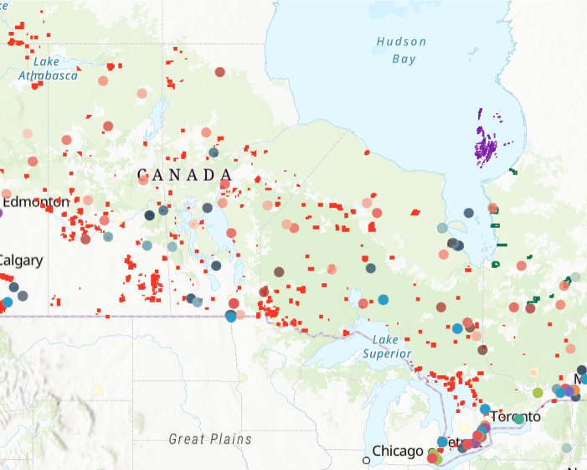
Canadian Disaster Dataset
1,000+ Canadian disasters since 1900
Natural, tech, and conflict events
Key fields: type, date, location, deaths, evacuees, cost
Available on Kaggle & open.canada.ca

Slide 7
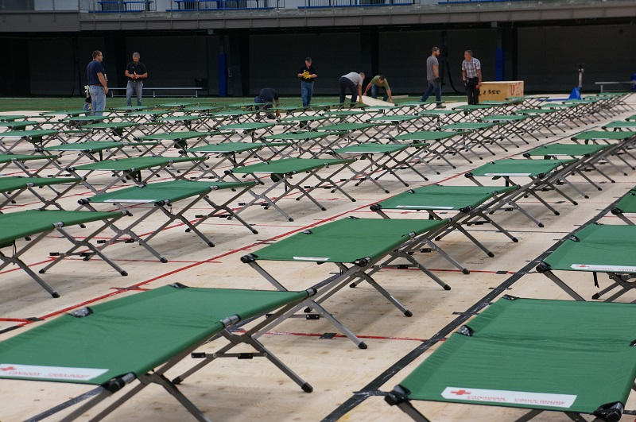
What We Aim to Explore
Prediction
Patterns
Drivers
Can disaster trends be modeled to support future predictions?
Are there patterns in type, location, or impact over time?
What factors drive large-scale evacuations or responses?

Slide 8

Analyzing Trends, Rankings, and Match Outcomes in Women’s Tennis
——WTA(Women's Tennis Association) Insights
02
Kan Zhou

Slide 9

WTA Insights——Dataset Overview
Repository——tennis_wta
Limitations
Key Features
https://github.com/JeffSackmann/tennis_wta
Published by Jeff Sackmann
No real-time data
Last updated at 2024
No injury
No live status info
No weather info
Need to add 2025 data manually
Free and open-source
Clean, structured CSV format
Historical WTA singles match data (1968–2024)

Slide 10
WTA Insights——Dataset Overview
Main Files
Sample Columns
wta_matches_YYYY.csv
Yearly match data
Each row = 1 singles match
WTA main matches (2024): 2,600
Other matches (2024): 38,000
wta_players.csv
Player info: name,handedness, Date of birth, country
70,000 players
wta_rankings_YYYY.csv
Weekly WTA rankings per year
Top 1000
wta_matches_YYYY.csv
Tournament name
Tournament start date
Court surface (Hard, Clay, Grass)
Match round (1R, QF, SF, etc.)
Match winner
Match score
wta_rankings_YYYY.csv
Ranking_date
Rank
Player_id
Ranking_points

Slide 11


WTA Insights——Project Goal
Trend Analysis
Ranking Dynamics
Performance Metrics
Match Outcome Prediction
Track player performance over time
Visualize weekly ranking changes
Generate KPIs such as win rate, average sets per match, or success by tournament level
Match outcomes between any two players

Slide 12
Project Timeline
Jul 24
Jul 31
Aug 12
Aug 14
Jul 21
Jul 28
Aug 07
Final Report
Trend Analysis & Ranking Dynamics
Model Training
Kickoff
Prediction Model Evaluation
Data Exploration
Performance Metrics & Feature Engineering

Slide 13
Canadian Crop Production Dataset
03
Yuqi Gu

Slide 14
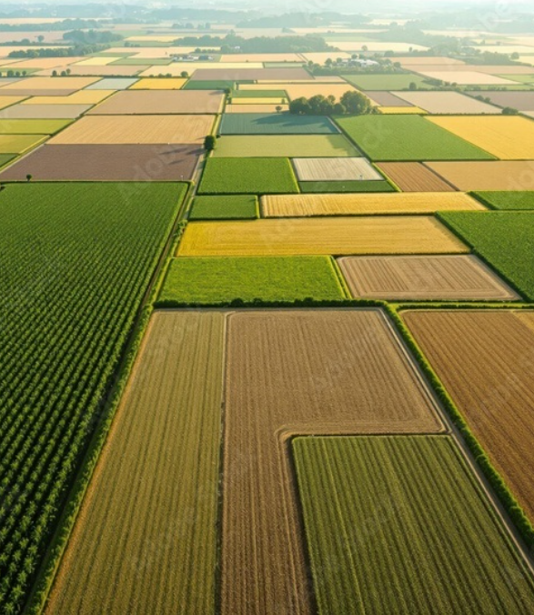
Canadian Crop Production
The Canadian government estimates that the production of all major field crops in Canada in 2024-25 is expected to be 88,048 thousand tonnes, with a planting area of 27,831 thousand hectares.
https://agriculture.canada.ca/en/sector/crops/reports-statistics/canada-outlook-principal-field-crops-2025-06-20

Slide 15
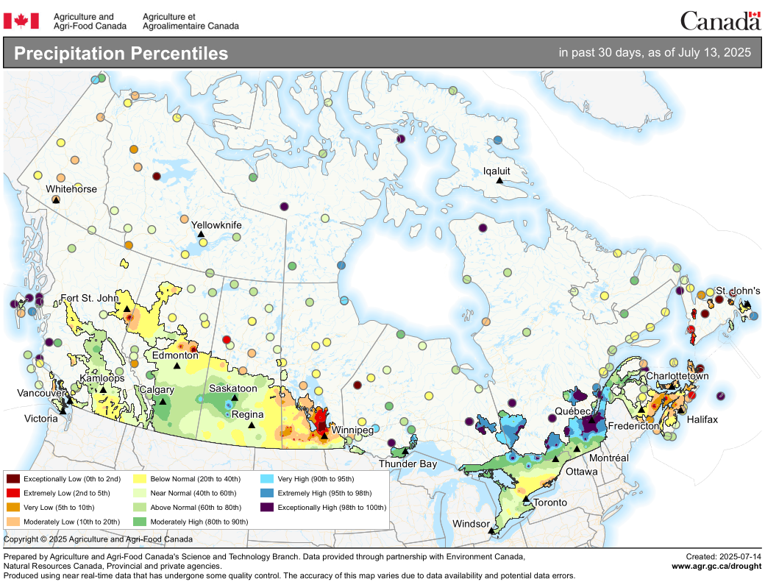
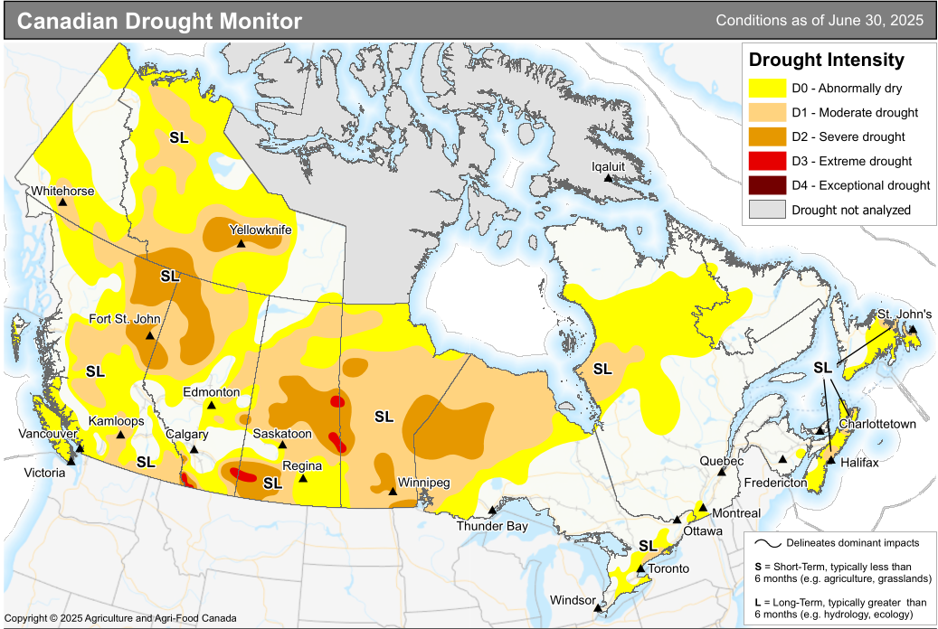
Factors affecting agriculture
High temperatures, water shortages, and droughts can reduce crop yields.
Cold temperatures and too much water can slow crop growth.
https://agriculture.canada.ca/en/agricultural-production/weather/national-agroclimate-risk-report

Slide 16
Crop Production Data
100 years Canadian Farm Produce Data
It includes information about crop types, average farm prices , average yields, total production, seeded areas, soil_type, irrigation_used, avg_rainfall_mm, avg_temperature_c, and the total farm value.
Each entry is categorized by year and province, providing a comprehensive view of agricultural trends in Canada over time.
Available on Kaggle

Slide 17

What We Aim to Explore
Understanding
Analysis
Prediction
Explore the structure, quality, and key features of the agricultural dataset.
Identify trends and patterns through statistical and visual exploration.
Build forecasting models to predict future crop yields.

Slide 18
THANKS
Do you have any questions?

